Slide 1
Mobile Application Dev
SCS 2210
Lecture 1: Introduction to Mobile Platforms

Slide 2
1.1 Introduction to Mobile App development
Demand of mobile applications used with Tablets, Mobile phones, and Wearables has been growing at a relatively fast rate at individual level and enterprises in the pass decade. Mobile applications have become ubiquitous in sport, health, digital marketing, social networking, banking, education, financial markets, stock trading, etc.
Development of mobile applications has become an important subfield of the general software development field were the target operating platform is mobile. These applications are either developed for a specific mobile operating system or cross platform use.
Meeting the demands of mobile application users requires enterprise application developers to reassess their development strategy when moving from traditional web applications to mobile apps. They must make decisions concerning which platform(s) to develop for and whether to use a native, browser or hybrid approach.

Slide 3
1.2 Mobile Application Development Frameworks
Definition:
A mobile development framework is a comprehensive tool that developers use to create successful mobile applications. They offer developers the needed access to a collection of code libraries, API tools, SDKs, etc., and help build feature-rich apps without having to start from scratch. Another way to define these frameworks is a basic structure that helps you add more details to your code in accordance with custom code and offer a sustainable environment for custom mobile application development
Categories of mobile development frameworks
1. Native Mobile App Development Framework
These frameworks are used to build native applications for a dedicated platform. They are typically designed to satisfy the requirements of a particular operating system (OS) that includes Windows, iOS, and Android.
2. Web App Development Framework
Simply known as a web framework, it is a software technology that helps programmers practice smooth web app development for web application programming interfaces (APIs), web servers, and web services. Web app software is distributed via Web using a browser interface e.g. email, weblogs, instant messaging apps.
3. Hybrid App Development Framework
It is a hybrid/cross platform mobile apps framework that can be used to develop cross platform applications. It possesses the abilities of both native and web development frameworks.

Slide 4
Top Mobile App Development Frameworks
1. Flutter
Flutter is an open and free framework from Google that allows you to create native Android and iOS applications with a simple codebase. It’s a ground-breaking SDK for cross-platform application development, which distinguishes it because it takes a novel way of creating native-like apps.
Flutter is a comprehensive and precise framework that contains widgets, a rendering engine, debugging and integrating APIs, and resources to assist developers in creating and deploying beautiful mobile applications.
Features of Flutter –
More rapid development.
Cross-platform.
Visuals that are both appealing and engaging.
Performance that is pretty similar to that of a native
2. React Native
An accessible, cross-platform application development framework that has quickly become the preferred option of programmers. React Native facilitates the development of Android and iOS mobile applications. The most exemplary instances of React Native apps are those from prominent businesses like Tesla, Airbnb, Skype, or Amazon Prime.
Features of React Native –
Exceptional performance
Components that can be reused
Compatibility with third-party extensions

Slide 5
Top Mobile App Development Frameworks continued…
3. Xamarin
Xamarin is an alternative cross-platform application development framework for developing applications for Android and iOS. Because they employ the C# programming language, the applications need fewer lines of code. As a result, the process of coding is quicker. Also, it allows us to rapidly transfer the scripts across other systems, such as Windows and macOS.
Features of Xamarin
Rapid Advancement
Appearance and touch of a native app
Compatibility with a variety of devices
4. Iconic
Is an open-source AngularJS-based platform that helps create robust web, native, and hybrid applications utilizing CSS, JavaScript, and HTML technologies. Apps built with Ionic can be successfully published across multiple app stores and installed on all the available devices via Cordova or Capacitor.
Features of Iconic
App development for many platforms.
The user interface is consistent.
Enhanced performance.
The flexibility of the user

Slide 6
1.3 Classes of Mobile Applications (native, web-based, cross-platform)
Native apps
Developed for a platform of your choice that allows creating a better user experience. It means that app developers have to write two different codebases in case they’re going to launch an app on two platforms. Each of the platforms has its distinctive characteristics.
For instance, for iOS app development, software developers usually use Objective-C and Swift, while native Android applications are written in Java or Kotlin.
Advantages:
Facilitated Integration And Compatibility With Devices.
Outstanding Performance.
Eye-Catching UI/UX
Disadvantages:
You Need to Write Code for Each Platform
Two Times Higher Development Cost
Two Times Higher Maintenance Cost
Examples Native App Dev Tools & technologies:
For iOS: Xcode, AppCode etc. For Android: IntelliJ IDEA, Android Studio
Example Native apps: Google Maps, Twitter, Facebook,

Slide 7
1.3 Classes of Mobile Applications (native, web-based, cross-platform) continued….
2. Web apps
Developed for different platforms and run inside a browser on the respective platform. One of the features that also differs web apps from native apps is that users can only perform most of the tasks with the help of the Internet.
Besides, web applications’ front-end is written with JavaScript and HTML, which are browser-supported languages, and back-end is written with Java and Python. You usually need to take more steps to open such an application, but you can use it with any device, whether it’s Android, iOS, or PC.
Advantages:
Simple in Development
Lower Cost and Timing
Available on Every Device with Internet Connection
Easily Updatable
Disadvantages:
The Quality of A Web App Depends on A Browser
Not Very Convenient in Operation
Examples of Web app Dev Tools & Technologies
Django, Angular, React

Slide 8
1.3 Classes of Mobile Applications (native, web-based, cross-platform) continued….
2. Cross platform
“Write once, run anywhere” is how we can describe cross-platform apps briefly. This type of application can be used on various platforms, and you don’t need to write a codebase for each of them.
For cross-platform apps, you create a single codebase that works on many platforms regardless of the OS you choose, whether it’s Android, iOS, Mac, Linux, or Windows.
Advantages:
Reusable and Shareable Code
Cost- and Time-Effective
High-Quality UI/UX
Disadvantages:
Lack of Native Modules
Lack of Updates
Lack of 3D Support
Examples of Cross platform App Dev Tools & Technologies
Flutter, React Native, Iconic
Example Native apps: Instagram, Skype, Adobe Flash Player

Slide 9
1.4 Virtual Environments in Mobile Systems
Mobile virtualization
Mobile virtualization is an approach to mobile device management in which two virtual platforms are installed on a single wireless device. A platform is simply an underlying computer system on which application programs can run.
A smartphone, for example, might have one virtual environment for business use and one for personal use. Applications and data in the two environments would remain isolated, protecting corporate data. Mobile virtualization might also allow one device to run two different operating systems (Oses).
Next-generation smartphones and tablets will run multiple operating systems and powerful cloud applications like high-definition gaming thanks to the growing use of virtualization on mobile devices.
A new generation of mobile devices containing faster processors could help applications run faster, while virtualization could help consolidate applications without wasting resources

Slide 10
1.5 Mobile Operating Systems
A mobile operating system is an operating system for mobile phones, tablets,
smartwatches, 2-in-1 PCs, smart speakers, or other mobile devices. While computers such as typical laptops are 'mobile', the operating systems used on them are generally not considered mobile ones, as they were originally designed for desktop computers that historically did not have or need specific mobile features. This distinction is becoming blurred in some newer operating systems that are hybrids made for both uses.
A mobile operating system allows the user to run other different application software on the mobile phone, tablet, etc.
The operating systems found on smartphones include Symbian OS, iPhone OS, RIM's BlackBerry, Windows Mobile, Palm WebOS, Android, and Maemo. Android, WebOS, and Maemo are all derived from Linux. The iPhone OS originated from BSD and NeXTSTEP, which are related to Unix.

Slide 11
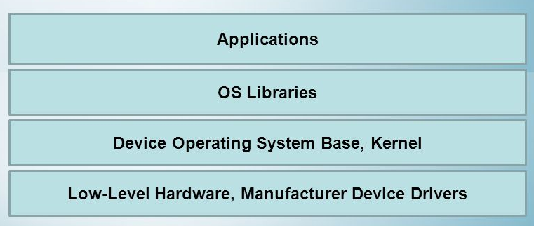
1.5 Mobile Operating Systems continued..
Mobile OS Architecture
An illustration of the general structure of a mobile operating is shown in figure 1.1
Figure 1.1 General Mobile OS architecture

Slide 12
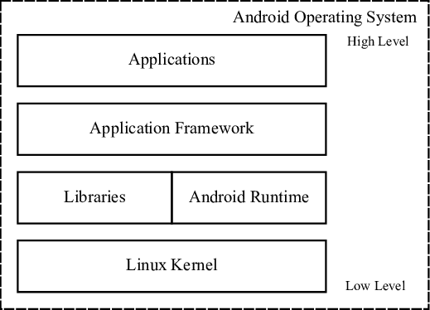
1.5 Mobile Operating Systems continued..
Android OS Architecture
An illustration of the android structure of a mobile operating is shown in figure 1.2
Figure 1.2 Android OS architecture

Slide 13
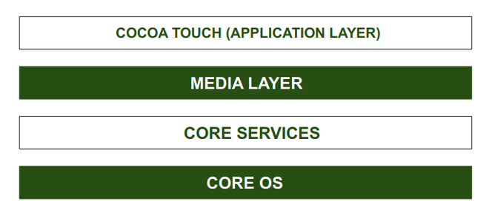
1.5 Mobile Operating Systems continued..
iOS Operating System Architecture
An illustration of the android structure of a mobile operating is shown in figure 1.3
Figure 1.3 iOS Operating System architecture

Slide 14
1.5 Mobile Operating Systems continued..
Types of Popular Mobile Operating Systems
Android OS (Google Inc.)
The Android mobile operating system is Google’s open and free software stack that includes an operating system, middleware, and key applications for use on mobile devices, including smartphones. Updates for the open source Android mobile operating system have been developed under “dessert-inspired” version names (Cupcake, Donut, Eclair, Gingerbread, Honeycomb, Ice Cream Sandwich, Jelly-bean, KitKat or Lollipop, Marshmallow), with each new version arriving in alphabetical order with new enhancements and improvements.
Because of adaptability in apps and productivity in OS including the availability of FREE apps, the Android OS is the leader and dominant OS with wide numbers of users.
The file extension of Android app is .apk used to install apps on OS
2. Windows Phone (Microsoft Inc.)
Developed by Microsoft as like computer OS – it’s just like a refurbished version of PC OS but especially design and developed for the mobile platform. Initially, Nokia had stopped the development of Symbian OS, that is now acquired by Microsoft, and it transformed into Windows OS as the main OS for their smartphones. Microsoft Corporation Inc. declared its new smartphone platform ‘Windows Phone’ on Feb 2010.
The Mobile OS is based on the Windows CE 5.2 kernel. This Windows OS has its own unique GUI [graphical user interface]- called a tiles-based user interface - that makes them more stylish as compared with its competitors.

Slide 15
1.5 Mobile Operating Systems continued..
Types of Popular Mobile Operating Systems
3. iOS Operating System (Apple Inc.)
operating systems for mobile devices specially designed and developed for the use of Apple devices like iPhone, iPad & iPod, etc. It's programmed in C, C++, Objective-C, Swift
The company does not license the iOS for third-party hardware, so this operating system is only available on their manufactured devices as its core base is provided by the Apple Mac OS X operating system.
Usually, the file extension used of iOS apps is .ipa file package that you can use to install directly via iTunes software which is specially designed for iPhone, iPad, and other iDevices.
4. webOS (Palm/HP)
WebOS is a mobile operating system that runs on the Linux kernel. WebOS was initially developed by Palm as the successor to its Palm OS mobile operating system. It is a proprietary Mobile OS which was eventually acquired by HP and now referred to as webOS (lower-case w) in HP literature.
HP uses webOS in a number of devices including several smartphones and HP TouchPads. It has pushed its webOS into the enterprise mobile market by focusing on improving security features and management with the release of webOS 3.x.

